Slide 1


Reproducing HIAC Experiments: A Detailed Report
This report details the successful reproduction of Hierarchical Information-theoretic Affinity Clustering (HIAC) experiments. We will explore the methodology, parameters, and results obtained from applying HIAC to the Wireless Indoor Location dataset, alongside a regeneration of DPC experiments on various shape datasets.
SudentID: 1820259061 Kuranov Grigorii

Slide 2
HIAC Experiment Overview
Understanding the HIAC Workflow
Dataset Utilised
Script Execution
Key Outputs
The primary dataset for this experiment was data-sets/real-datasets/Wireless_indoor_location.txt, a real-world dataset crucial for indoor localisation research.
The HIAC.py script, located in the current directory, was executed to perform the clustering and analysis.
The script generates a decision graph image, an ameliorated dataset (<dataset>_ameliorated_by_HIAC.txt), and clustering results with Normalised Mutual Information (NMI) scores.

Slide 3
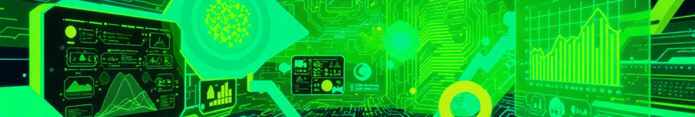
HIAC Experiment Parameters
k (neighbours): 6
Normalization: Min-max scaling per feature was applied directly within the script to ensure feature comparability.
T (time-step): 0.3
d (iterations): 4
Visualization: Principal Component Analysis (PCA) was used to reduce dimensionality to 2D for effective plotting, utilising sklearn.decomposition.PCA.
Threshold: 1.514
These parameters were carefully selected to optimise the performance of the HIAC algorithm on the specified dataset, balancing computational cost with clustering accuracy.
The chosen normalisation method helps prevent features with larger scales from dominating the clustering process, while PCA provides an interpretable visual representation of the high-dimensional data.

Slide 4

Initial Data Visualization: Original PCA Scatter
The initial two-dimensional PCA projection of the Wireless Indoor Location dataset is presented below. This visualization provides a baseline understanding of the data's inherent structure before the application of the HIAC amelioration process.
This original scatter plot helps to identify any obvious clusters or data distributions prior to the clustering algorithm's influence, serving as a critical reference point for evaluating the ameliorated dataset.

Slide 5




Results Summary of HIAC Experiment
The HIAC pipeline generated several key outputs essential for analysis and further research. The ameliorated dataset and the clustering results are crucial for understanding the impact of HIAC.
Decision Graph Image
Ameliorated Dataset
Clustering NMI
A decision graph image was saved to the script's output folder, illustrating the density and delta values used for identifying cluster centres.
The modified dataset, <dataset>_ameliorated_by_HIAC.txt, was saved, representing the HIAC algorithm's enhancement of the original data.
The script performed clustering via the provided DPC implementation and printed the resulting Normalised Mutual Information (NMI) score, a critical metric for evaluating clustering quality against ground-truth labels.
For the exact numeric NMI value, please execute the script locally. The ameliorated dataset visualisation and decision-graph images are produced by the script and should be placed in the figures/ folder.

Slide 6
Reproducibility: How to Re-Run This Experiment
To ensure full transparency and allow for independent verification, follow these steps to reproduce the HIAC experiment results.
01
02
Activate Python Environment
Install Dependencies
Activate your preferred Python environment. For example, using the workspace virtual environment: source ../DWH_1_Detecting_novel_associations_in_large_data_sets/env/bin/activate
From the current folder, install any missing dependencies: pip install -r ../DWH_1_Detecting_novel_associations_in_large_data_sets/requirements.txt (or install numpy scipy pandas matplotlib scikit-learn individually).
03
04
Run the Script
Review Outputs
Execute the HIAC script: python HIAC.py.
The script will create a folder named after the dataset (e.g., wifi_localization) containing plots and the ameliorated data.

Slide 7

Notes and Suggestions for Experiment Enhancement
Several avenues exist for further enriching these experiments and facilitating analysis.
Image Embedding Convenience
Automated NMI and Images
I can embed the original.png image directly into the repository for easier access and consistency across reports. Please confirm if this is desired.
I can execute HIAC.py to capture the printed NMI values and generate all related images, installing any necessary dependencies into your chosen environment.
Parameter Sweep Wrapper
Additional Comparisons
A run_hiac_demo.py wrapper could be developed to streamline parameter sweeps and automate the saving of results, enhancing experimental efficiency.
A short script could be added to compute and display NMI before and after HIAC for other clustering algorithms like K-Means or Agglomerative Clustering, providing broader comparative insights.

Slide 8
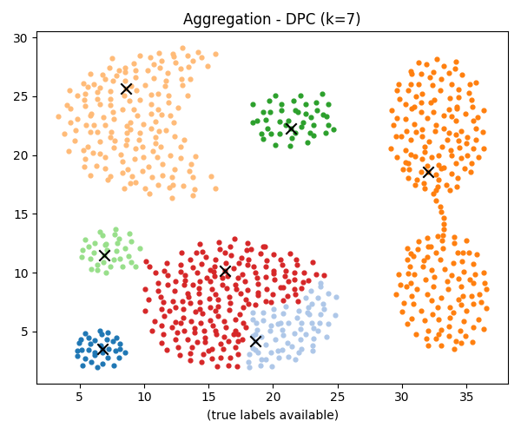
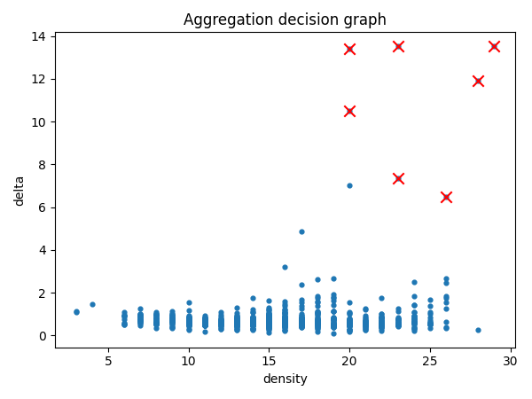
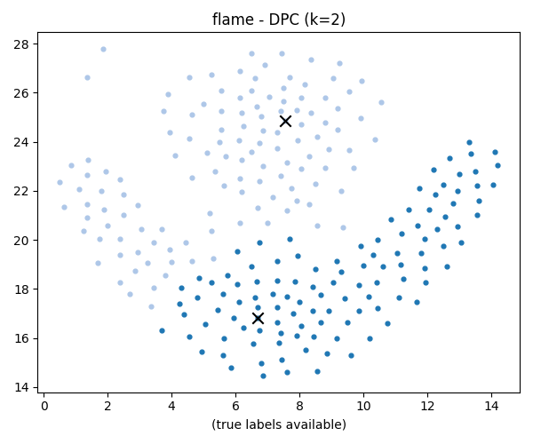
DPC Experiment
The DPC experiments were re-executed for various example shape datasets, with all outputs saved in the outputs/ folder. This regeneration provides updated visualisations and quantitative metrics for evaluation.
These visualisations include cluster assignments and decision graphs for each dataset, offering comprehensive insights into the DPC algorithm's performance on different data structures.

Slide 9
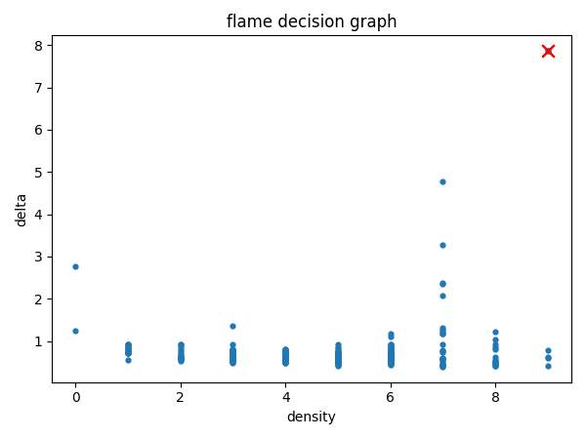
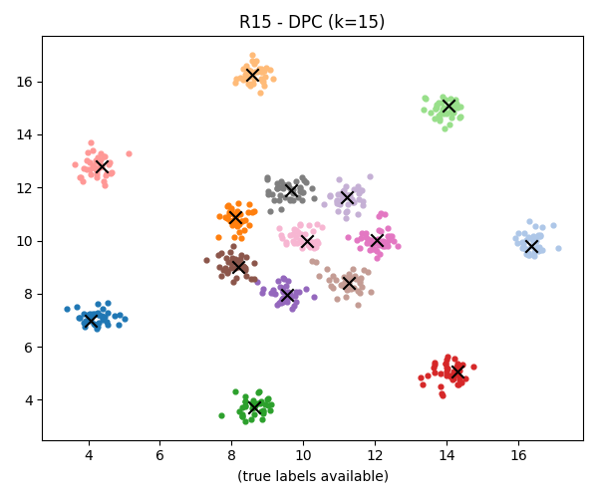
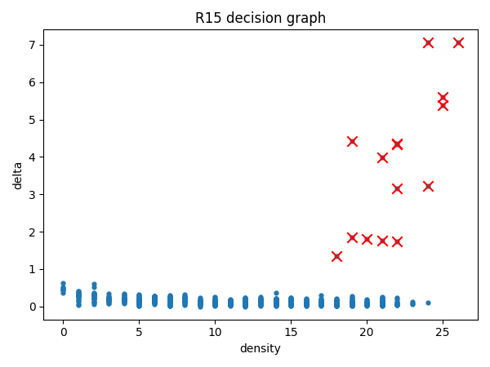

Slide 10
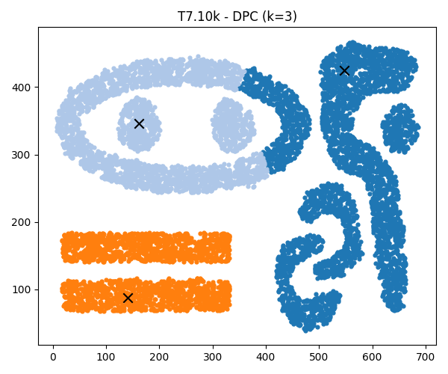
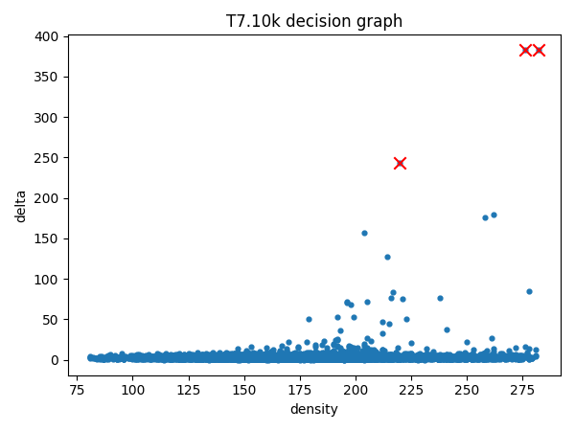


Slide 11
Summary of Numeric Results from DPC Regeneration
The outputs/dpc_results.csv file contains a detailed summary of the quantitative performance metrics for the regenerated DPC experiments.
R15
15
0.98213
0.98644
outputs/R15_clusters.png
outputs/R15_decision.png
Aggregation
7
0.73187
0.88072
outputs/Aggregation_clusters.png
outputs/Aggregation_decision.png
flame
2
0.45341
0.49010
outputs/flame_clusters.png
outputs/flame_decision.png
T7.10k
3
(no labels)
(no labels)
outputs/T7.10k_clusters.png
outputs/T7.10k_decision.png
The Adjusted Rand Index (ARI) and Normalised Mutual Information (NMI) are presented where ground-truth labels were available, demonstrating varying degrees of clustering accuracy across different datasets.

Slide 12

Next Steps and Future Directions
To further advance this research, two primary paths are available based on your immediate needs.
Presentation Generation
Alternative Parameter Exploration
I can construct a PowerPoint presentation (DPC_experiment_presentation.pptx) embedding all generated images and a concise summary of these DPC results, suitable for immediate sharing.
Alternatively, I can re-run the experiments with different radius/percentile values, or explore kernel density estimation instead of the hard cut-off, appending these new results for deeper analysis.
Please indicate your preference for the next course of action to continue this experimental work efficiently.

